Slide 1
A high performance geneticalgorithm using bacterial conjugation operator (HPGA)
By : amir modadnejad
Supervisor : Dr.agdasi
Tabriz university

Slide 2
contents
Introduction
bacterial conjugation in Nature
HPGA algorithm
Implementation of Bacterial conjugation
Example
The advantages of the proposed algorithm
Experiment and result
Conclusion
Reference

Slide 3
Introduction
In recent decades, the genetic algorithm (GA) has been extensively applied to a large number of optimization problems with considerable success
biological operators are the key inspiration for many operators of evolutionary algorithms (EAs) such as chromosome crossover and mutations.
Most research related to this issue focus on developing adaptive behaviors for these operators

Slide 4
Introduction
This proposes an efficient evolutionary algorithm called HPGA
HPGA uses another genetic mechanism as an optimization operator called bacterial conjugation that is the direct transfer of genes between bacterial cellsMost.

Slide 5
bacterial conjugation in Nature
Bacterial conjugation models a transfer procedure of the genetic material between bacterial cells that are in direct cell-to-cell connection
A Conjugation is a convenient means for transferring genetic material to a variety of targets. In laboratories, successful transfers have been reported from bacteria to yeast, plants, mammalian cells and isolated mammalian mitochondria.

Slide 6
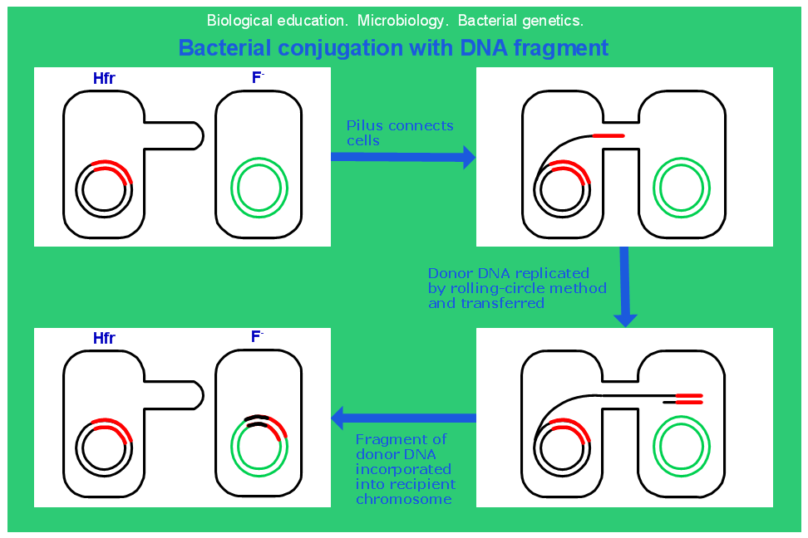
bacterial conjugation in Nature

Slide 7
HPGA algorithm
The main of this algorithm is the bacterial conjugacation (BC).
BC operator is divided into two main steps
Horizontal gene transfer
Competition

Slide 8
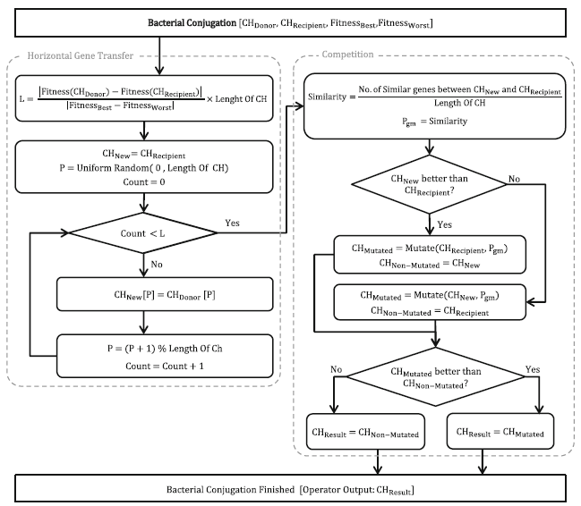
Block diagram of BC

Slide 9
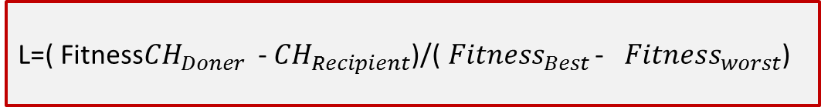

Horizontal gene transfer
L=( Fitness${CH}_{Doner}$ -${ CH}_{Recipient}$)/(${Fitness}_{Best}$ - ${Fitness}_{worst}$)
${CH}_{New}$=${ CH}_{Recipient}$
P=Random(1,Length of CH)
Count=0;
Competition
step
yes
Count<L
No
${CH}_{New}$[P]=${CH}_{\begin{aligned}Doner \\ \end{aligned}}[P]$
P=(P+1)%Length CH
Count=Count+1;

Slide 10
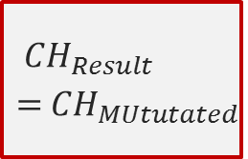
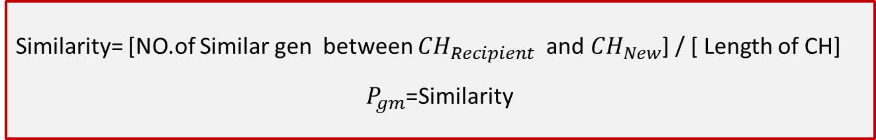




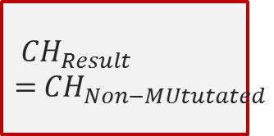
Competition
Similarity= [NO.of Similar gen between ${CH}_{Recipient}$ and ${CH}_{New}$] / [ Length of CH]
$P_{gm}$=Similarity
No
${ CH}_{New}$ better than ${ CH}_{Recipient}$
yes
${ CH}_{MUtutated}=$Mututated(${CH}_{Recipient}$, $P_{gm}$)
${ CH}_{Non−MUtutated}$=${ CH}_{New}$
yes
${ CH}_{MUtutated}=$Mututated(${ CH}_{New}$, $P_{gm}$)
${ CH}_{Non−MUtutated}$=${CH}_{Recipient}$
${ CH}_{MUtutated}$ better than ${ CH}_{Non−MUtutated}$
$${ CH}_{Result}={ CH}_{MUtutated}$$
$${ CH}_{Result}={ CH}_{Non−MUtutated}$$
No
yes

Slide 11
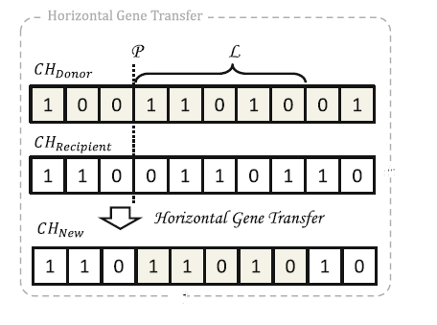
Example of Horizontal transfer

Slide 12
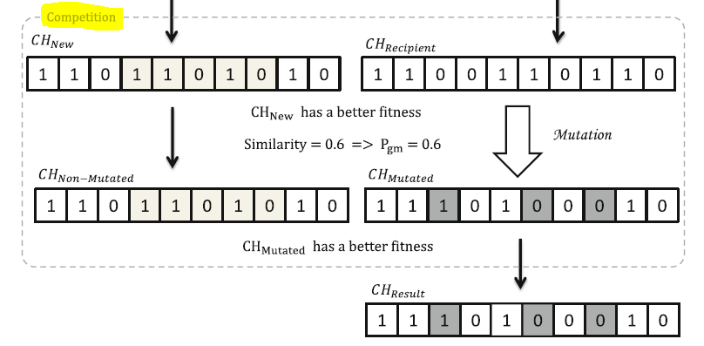
Example of Competion

Slide 13
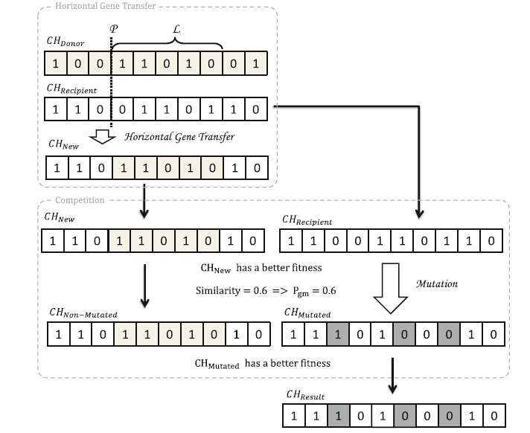
Example BC

Slide 14
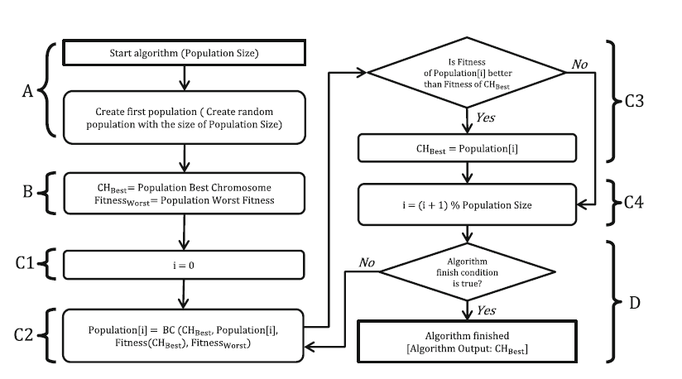
Block diagram of HPGA

Slide 15
The advantages of the proposed algorithm (1)
The proposed algorithm as a combination of PSO and SGA algorithm
The PSO algorithm uses its ‘‘move’’ operator to improve its individuals. Similarly, the proposed algorithm uses its BC operator to improve the individuals based on the global best and applies this operator to all the individuals in the population. In addition, the gene transfer operator procedure in the BC is somewhat similar to the crossover operator of SGA. Therefore a two-point crossover operator is implied in the BC operator and the crossing length is calculated using a more informed method, which is based on the population state. This mechanism makes the implied operator rate a self-adaptive one.

Slide 16
The advantages of the proposed algorithm (2)
2. Fewer input parameter
One of the advantages of the proposed algorithm is that it contains fewer input parameters; therefore, it does not need any special skill or expertise to use. The only input parameter of the algorithm is the population size.
Number of parameter is important in mane domain such real time problems.

Slide 17
The advantages of the proposed algorithm (3)
3. Better performance
Removal of the crossover operator computations
Removal of the sorting and operand selecting steps
The ease of implementation compared with other evolutionary methods
Lack of stagnation and premature convergence

Slide 18
Experiments and results
In this section, the performance and results of the proposed algorithm are compared with SGA and PSO by solving 23 benchmark functions [10] and two extended knapsack and travelling salesman problems. Also, the performance of the proposed algorithm will be examined by solving a robotic problem which requires a real-time response, and the results will be compared with SGA and PSO.

Slide 19
Conclusion
Considering the results obtained from the proposed algorithm, compared to SGA
and PSO, and considering the fact that the implementation of the proposed algorithm is simpler and its runtime is faster than SGA and PSO, it is an appropriate approach for real-time applications, and a suitable alternative to SGA. In addition, the higher performance and speed of the proposed algorithm makes it a good candidate for solving pseudo real-time problems. Having the population size as the only parameter of the proposed algorithm, and its linear dependence with respect to the total order of the algorithm execution, approximates the overall costs of the proposed algorithm to those of parameter-less EAs. Consequently, the proposed algorithm can act as a complete self-adaptivealgorithm.

Slide 20
Reference
1. L. Huang, L.-x. Ding, W.-w. Du, Improved self-adaptive genetic algorithm with varying population
size, in Proceedings of the 2009 Fifth International Conference on MEMS NANO, and Smart Systems
(ICMENS ’09) (2009), pp. 77–79
2. R. Breukelaar, T. Baeck, Self-adaptive mutation rates in genetic algorithm for inverse design of
cellular automata, in Proceedings of the 10th annual conference on Genetic and evolutionary
computation (GECCO ’08) (2008), pp. 1101–1102
3. A. Mehrafsa, A. Sokhandan, G. Karimian, A Timed-based approach for genetic algorithm: theory and
applications. IEICE Trans. Inf. Syst. E94-D(6), 1306–1320 (2011)
4. A.J.F. Griffiths, J.H. Miller, D.T. Suzuki, R.C. Lewontin, W.M. Gelbart, An Introduction to Genetic
Analysis, 8th edn. (W. H. Freeman, New York, 2004)
5. I. Harvey, The Microbial Genetic Algorithm, Springer, Lecture Notes in Computer Science, vol.
5778 (2011), pp. 126–133
6. P. Smith, Conjugation—a bacterially inspired form of genetic recombination, in Proceedings of Late
Breaking Papers at the Genetic Programming Conference (1996), pp. 167–176
7. C. Perales-Gravan, R. Lahoz-Beltra, An AM radio receiver designed with a genetic algorithm based
on a bacterial conjugation genetic operator. IEEE Trans. Evol. Comput. 12, 129–142 (2008)
8. N.E. Nawa, T. Furuhashi, Fuzzy system parameters discovery by bacterial evolutionary algorithm.
IEEE Trans. Fuzzy Syst. 7, 608–616 (1999)

Slide 21
Any question ?
Thank you

